Slide 1
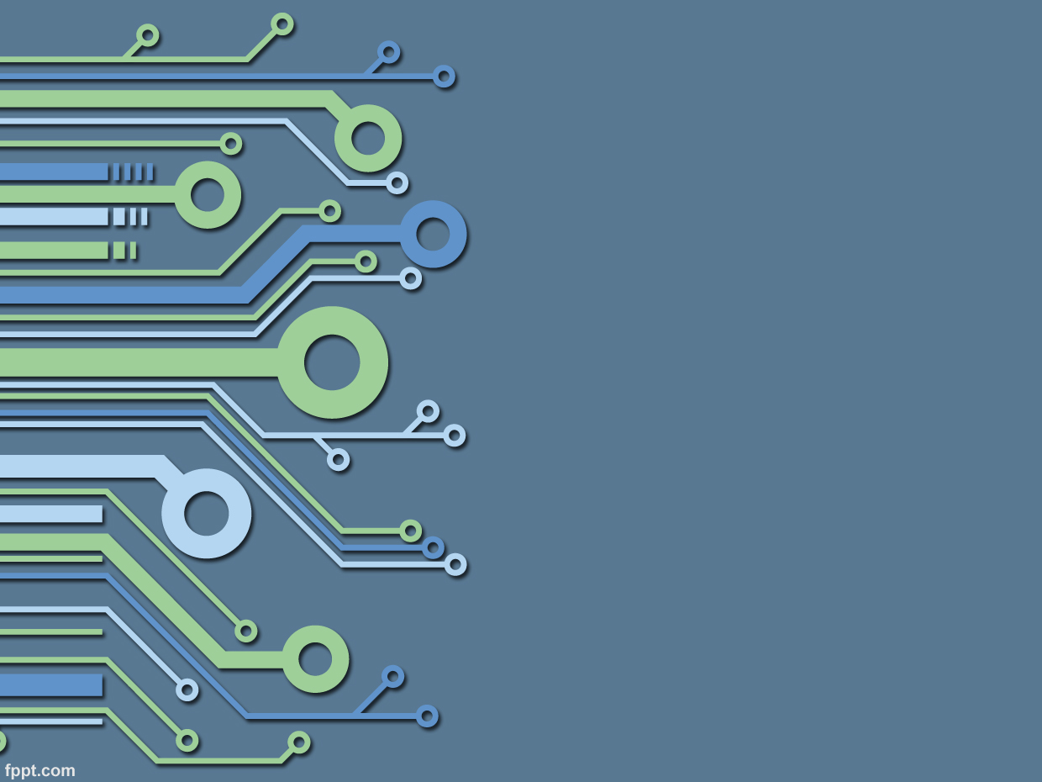
CAN-BUS Home Automation
TechBytes
Barclays Prague
Lubos Housa
October 2018

Slide 2
Agenda
History
CAN BUS
Target state
DEMO
Custom PCBs with Eagle
Programming chips in MPLAB IDE
Challenges
Future

Slide 3
History
Learn something new
Web development
Raspberry Pi -> BUS
CAN-BUS, DeviceNet, CanOpen, etc
Very Simple Can Protocol
Custom PCB, Custom protocol on CAN

Slide 4
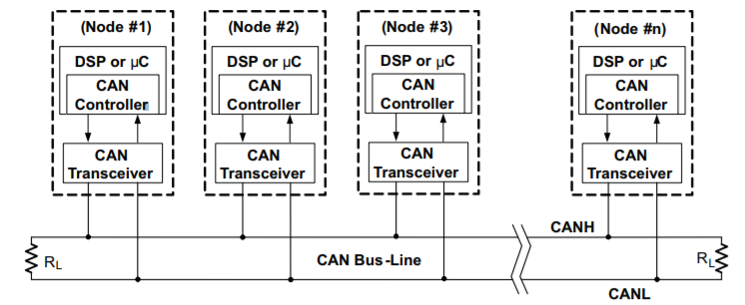
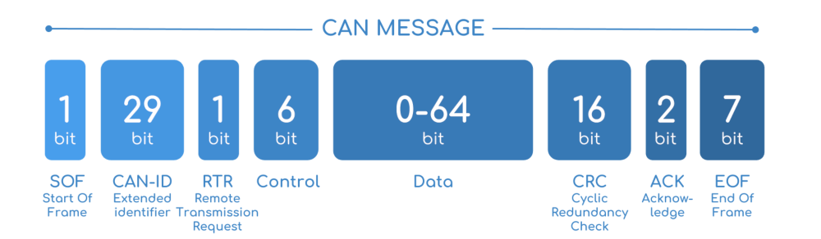
CAN BUS

Slide 5
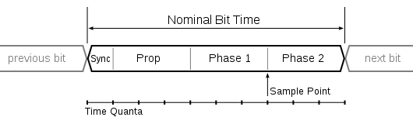
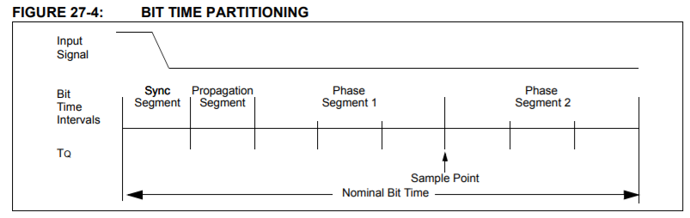
CAN Bit timing

Slide 6
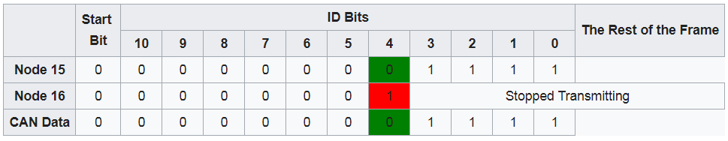
CAN Arbitration

Slide 7
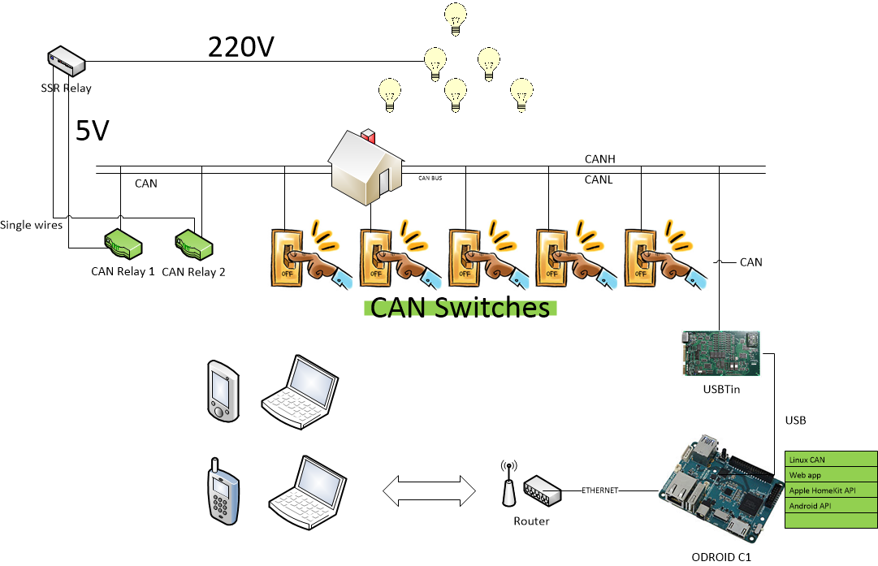
Target state

Slide 8
DEMO solution

Slide 9
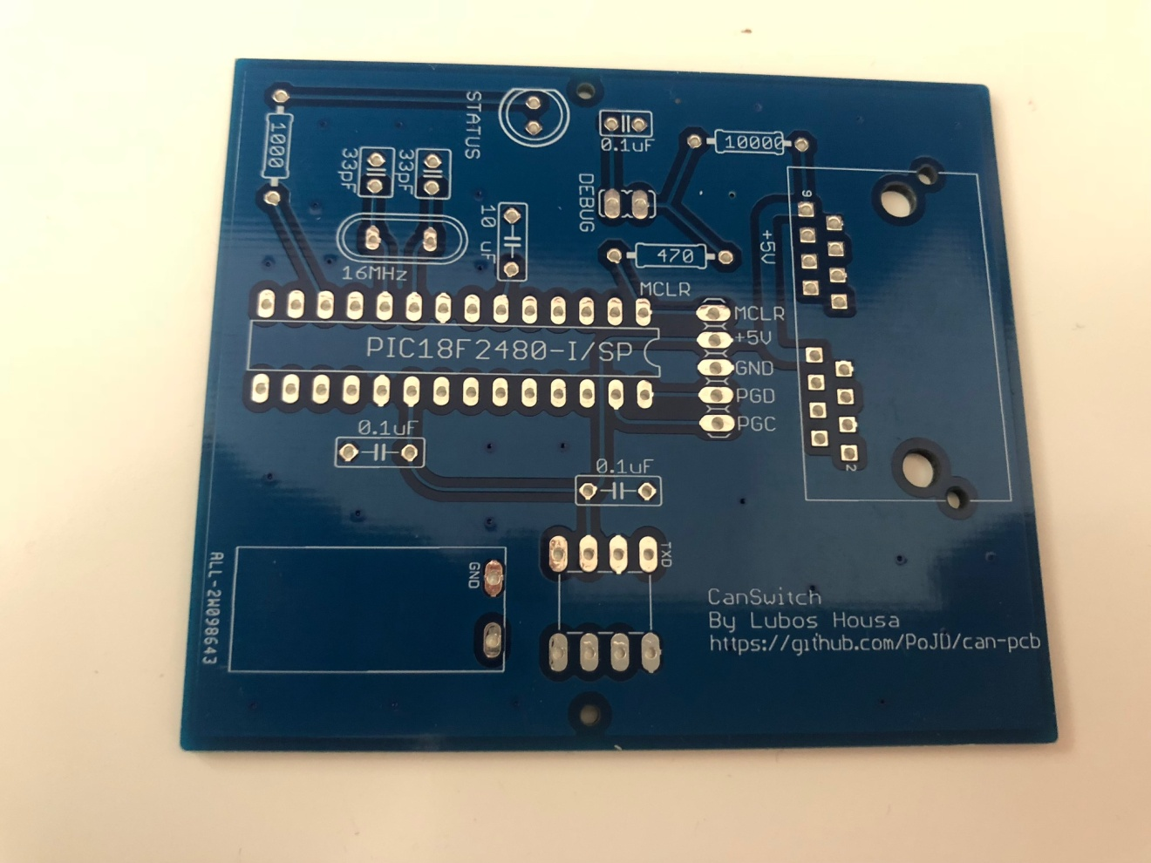
Custom PCBs with Eagle

Slide 10

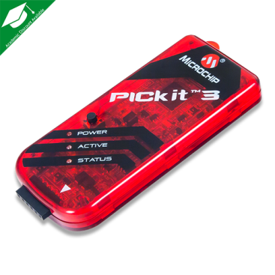

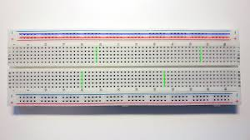
DEMO MPLAB IDE

Slide 11
Challenges
Out of CAN specification
Length of the bus, number of nodes
Power over CAT5
Voltage drop vs CAN baudrate
Testing/Reliability

Slide 12
USBTin integration

Slide 13
Future
Solder latest PCBs, fix all tickets
Test all
Custom 3D printed cases?
USBTin integrate into Odroid (docker)
Apple HomeKit / Android integration
Web app?
Custom security system?
Odroid integrating house to HomeKit

Slide 14
Links
https://en.wikipedia.org/wiki/CAN_bus
https://www.csselectronics.com/screen/page/simple-intro-to-can-bus/language/en
http://www.ti.com/lit/an/sloa101b/sloa101b.pdf
https://www.microchip.com/wwwproducts/en/PIC18F25K80
https://www.microchip.com/wwwproducts/en/MCP2561
https://github.com/PoJD/can-pcb
https://github.com/PoJD/eagle
https://github.com/PoJD/can
https://github.com/PoJD/piclib

Slide 15

Q&A

